Slide 1
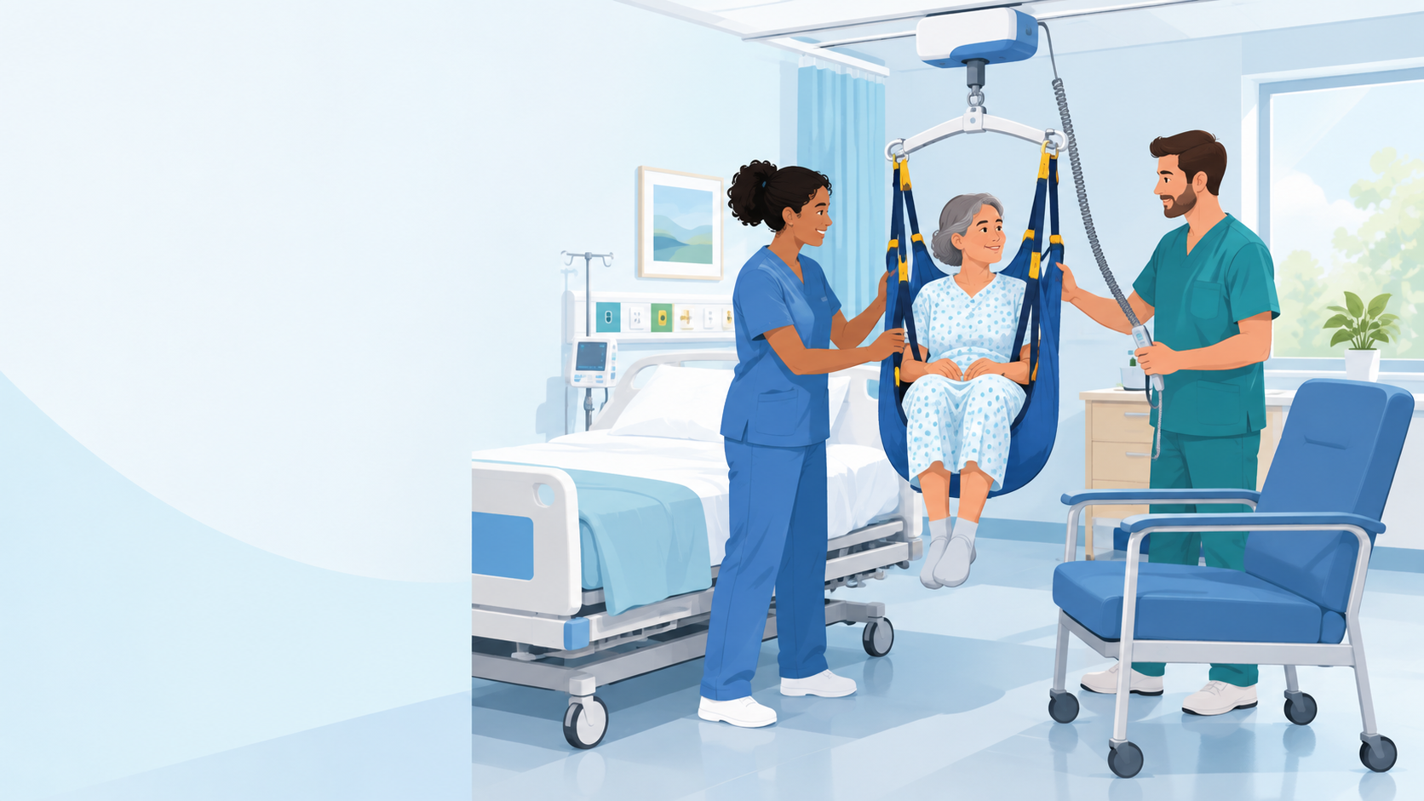
NEW EMPLOYEE ORIENTATION
The Safe Patient Handling and Mobility Program
How it relates to you and your job
Daniel Agbogidi, BSN, RN
Safe Patient Handling & Mobility Program Manager
VA Central California Health Care System
Notes:
Welcome everyone. I'm Daniel Agbogidi, the Safe Patient Handling and Mobility (SPHM) Program Manager here at VA Central California.
Over the next few minutes we'll cover:
- Why SPHM is a national and local requirement
- Why patient handling injures so many health care workers
- What our SPHM program provides: people, training and equipment
- What it means for you on the job: use the equipment, plan the move, ask for help, and don't manually lift more than 35 lb of patient weight.

Slide 2
SPHM is a national and local priority
1
2
VHA Directive 1611
Establishes Safe Patient Handling and Mobility as a Veterans Health Administration priority: every VA medical facility must run an SPHM program.
Medical Center Policy 118-21-013
Sets the Safe Patient Handling and Mobility policy for VA Central California Health Care System (VACCHS).
SPHM is required, not optional: nationally and here at VACCHS.
Notes:
Safe Patient Handling and Mobility isn't a local initiative. It's of nationwide importance.
1. VHA Directive 1611 establishes SPHM as a Veterans Health Administration priority. Every VA medical facility is required to implement an SPHM program.
2. Locally, Medical Center Policy 118-21-013 establishes the SPHM policy for VA Central California Health Care System, the policy that applies to you here.
Transition: Next, a short video from the American Nurses Association on why safe patient handling matters. [PLAY ANA VIDEO on the next slide.]

Slide 3
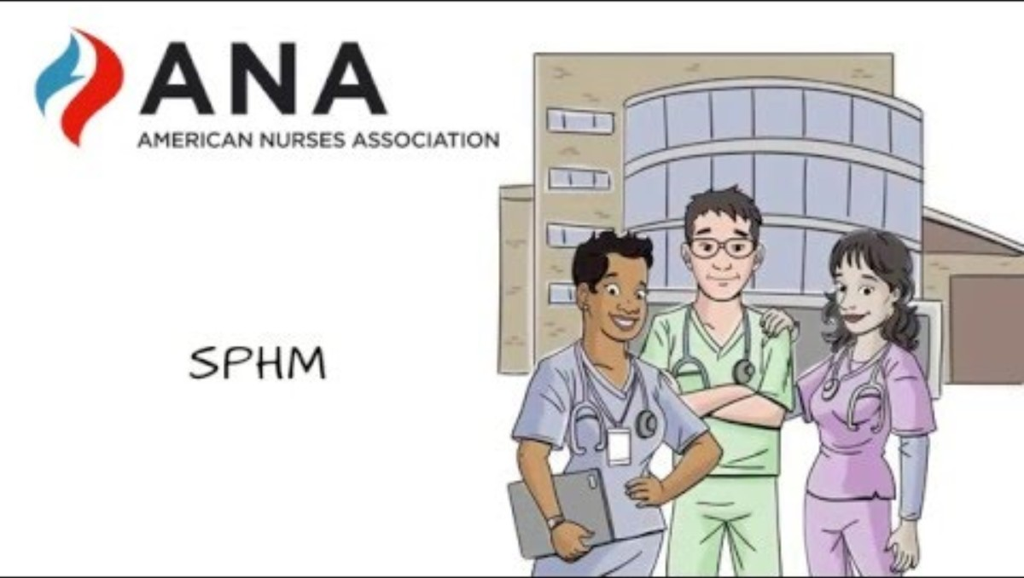
Video: ANA on safe patient handling and mobility
American Nurses Association · youtu.be/Bss2VEvrdcw
Notes:
[PLAY THE ANA VIDEO]
The American Nurses Association explains why safe patient handling and mobility matters for nurses and patients nationwide.
If the embedded video doesn't play, use the link under the video: https://youtu.be/Bss2VEvrdcw
After the video: Notice the themes. Injuries are common, they're preventable, and equipment plus a culture of using it is the answer. That's exactly what our program does.

Slide 4
VHA Directive 1611: what it requires
1
Every VA medical facility
must implement an SPHM program and build SPHM technology into the planning and design of new construction and renovations.
35 lb
of patient weight
Above this, or whenever a task needs excessive force, employees must use SPHM technology.
2
Use the technology
for routine and urgent tasks that lift more than 35 lb of patient weight, or that need excessive force, such as repositioning a Veteran in bed by pushing or pulling, or supporting a Veteran during mobility.
3
Protect people
Prevent injuries to health care workers and Veterans, and give every Veteran equitable access to SPHM technology.
4
Design input
All design projects in spaces used by Veterans must include input from the facility SPHM Program Manager.
Source: VHA Directive 1611, Safe Patient Handling and Mobility Program (transmittal July 11, 2023), section 1, Policy.
Notes:
This is the policy statement from VHA Directive 1611.
It is VHA policy that an SPHM program be implemented in every VA medical facility, and that SPHM technology be built into the planning, design and construction of new construction and renovation projects. The goals: protect VHA health care workers and Veterans from injuries due to patient handling and mobility, make sure every Veteran has equitable access to SPHM technology, and meet and improve Veteran care needs.
The line to remember (it's the highlighted part of the directive): employees MUST use SPHM technology for routine and urgent patient handling tasks that require lifting over 35 pounds of patient weight, or tasks that require excessive force, such as repositioning a Veteran in bed by pushing, pulling or supporting them during mobility.
Also: all design projects in spaces used by Veterans must include input from the facility SPHM Program Manager.
The July 2023 transmittal's main change was updating the program office title to Director, Office of Occupational Safety and Health.

Slide 5
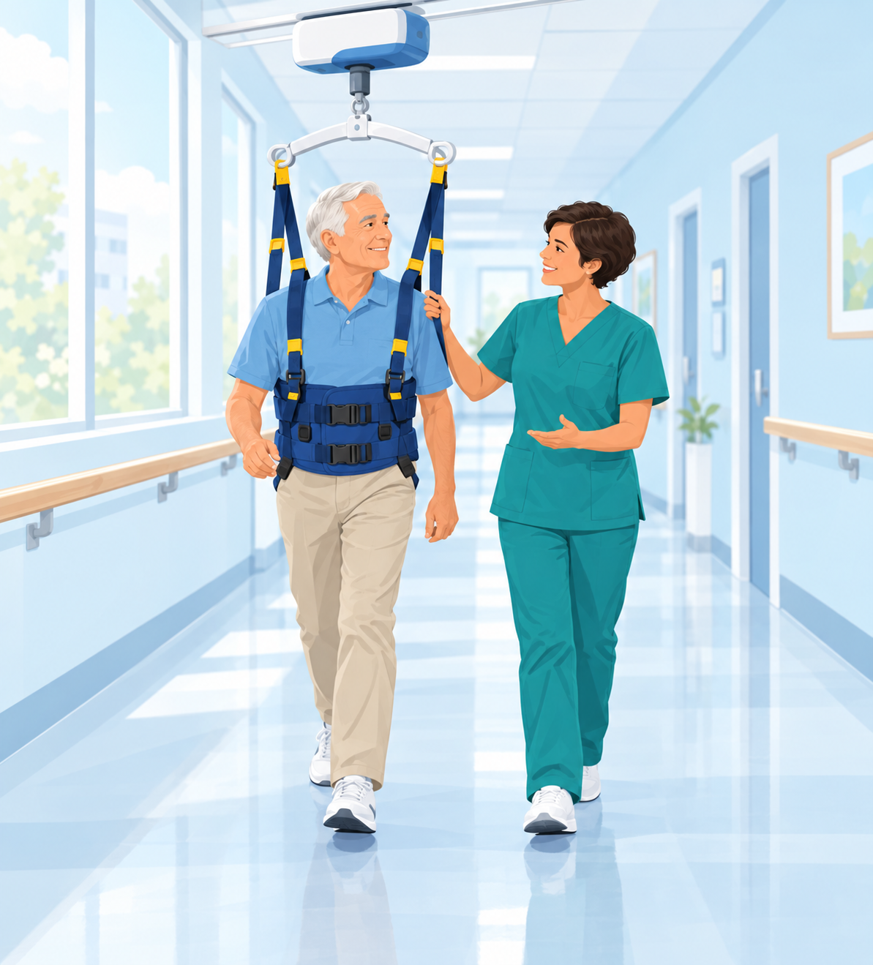
A safer environment of care
SPHM is changing the environment of care so we can move patients safely and with dignity, while improving patient outcomes.
1
Safer for staff
Equipment does the lifting: fewer strains and back injuries.
2
Better for Veterans
More dignity and comfort, and safer, earlier mobility.
3
Built into care
Equipment, training and room design work together.
Notes:
Why is there a need for an SPHM program? Because it changes the environment of care.
SPHM is about making it possible to move patients safely and with dignity, while improving patient outcomes. That means:
- Safer for staff: equipment such as ceiling lifts, floor lifts and air-assisted devices takes the load instead of your back.
- Better for Veterans: transfers are more comfortable and dignified, and patients can be mobilized earlier and more often.
- Built into care: equipment, training and room design (like ceiling-lift tracks over the bed) all work together.
[Illustration suggestion: a Veteran walking in a rehab hallway, supported by a ceiling-track gait harness, with a therapist beside him.]

Slide 6
Caregiver injuries: why SPHM is needed
1.8 tons
lifted by a nurse in one 8-hour shift without lift equipment
35 lb
patient lifting limit, even under the best of circumstances (cooperative, well-placed patient, no tubes or catheters)
2nd
nursing assistants' rank among ALL industries for injuries with lost workdays; nurses ranked 5th (BLS, 2012)
283
cases with days away from work per 10,000 FTE in health care in 2011, up 6%
MSIs
Musculoskeletal injuries are a primary driver of nurses leaving the workforce, and add to burnout and turnover
VA ↓
Injury rates are rising across health care, but steadily declining in VA
Notes:
Musculoskeletal injuries in caregivers are the reason SPHM exists.
- Without lift equipment, a nurse lifts an estimated 1.8 tons over an 8-hour shift.
- The recommended limit for lifting patient weight is 35 lb, and that's under the best circumstances: a cooperative, well-positioned patient with no tubes or catheters. Real patients rarely meet those conditions.
- 2012 Bureau of Labor Statistics data: among ALL industries, nursing assistants ranked 2nd and nurses 5th for injuries with lost workdays.
- Health care injury rates were increasing: up 6% in 2011, to 283 cases with days away from work per 10,000 full-time employees.
- These injuries are a primary driver of nurses leaving the workforce, and they contribute to burnout, turnover, preventable disability and early retirement.
The good news: while injury rates have been increasing across health care, VA rates are steadily declining. That's SPHM working.

Slide 7
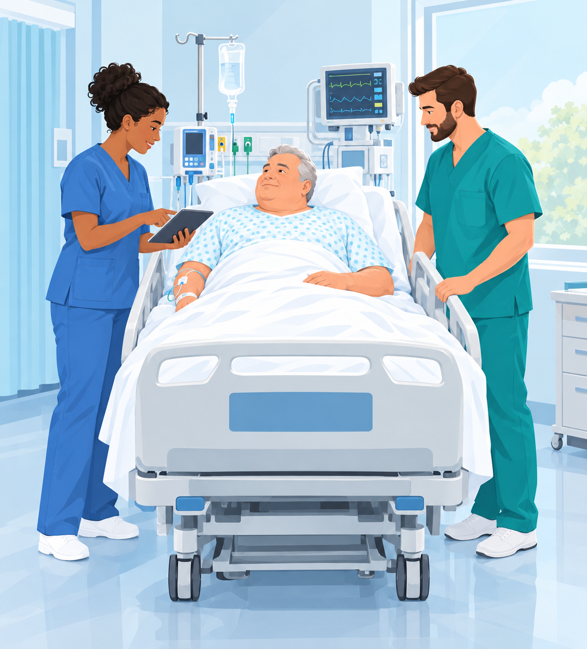
Why staff are at high risk
Patients have changed. Today's patients are:
1
Sicker
Higher acuity, more lines and equipment at the bedside.
2
More dependent
Need more physical help to move, turn and transfer.
3
Larger
Heavier patients increase the load on every move.
So... there is more risk of injury to staff.
Notes:
Why are patient care providers at such high risk? Because patients have changed.
- Patients are sicker: higher acuity, more lines, drains and monitoring at the bedside.
- Patients are more physically dependent on staff to move, turn and transfer.
- Patients are larger.
So there is more risk of injury to staff with every manual lift, transfer and reposition. That's why the equipment needs to be used every time.
[Illustration suggestion: two nurses at the bedside of an older, larger Veteran in a monitored ICU bed, planning the move.]

Slide 8
Half of U.S. adults could have obesity by 2030
If things continue the way they are now, about half of Americans will be obese by 2030.
More patients will need bariatric-capable equipment: lifts, slings, beds and chairs rated for higher weights.
Prevalence of obesity among U.S. adults aged 20–74 (%). Derived from NHANES data, CDC. 2030 value is a projection.
Notes:
Patients are getting larger, and the trend is continuing.
This chart shows the prevalence of obesity among U.S. adults aged 20 to 74, from NHANES (CDC) data: from about 11% in the early 1960s to about 36% by 2009–2010. If things continue the way they are now, about half of Americans will be obese by 2030.
What it means for us: more patients will need bariatric-capable equipment (lifts, slings, beds, wheelchairs and commodes rated for higher weights), and the risk of manual handling keeps going up.

Slide 9
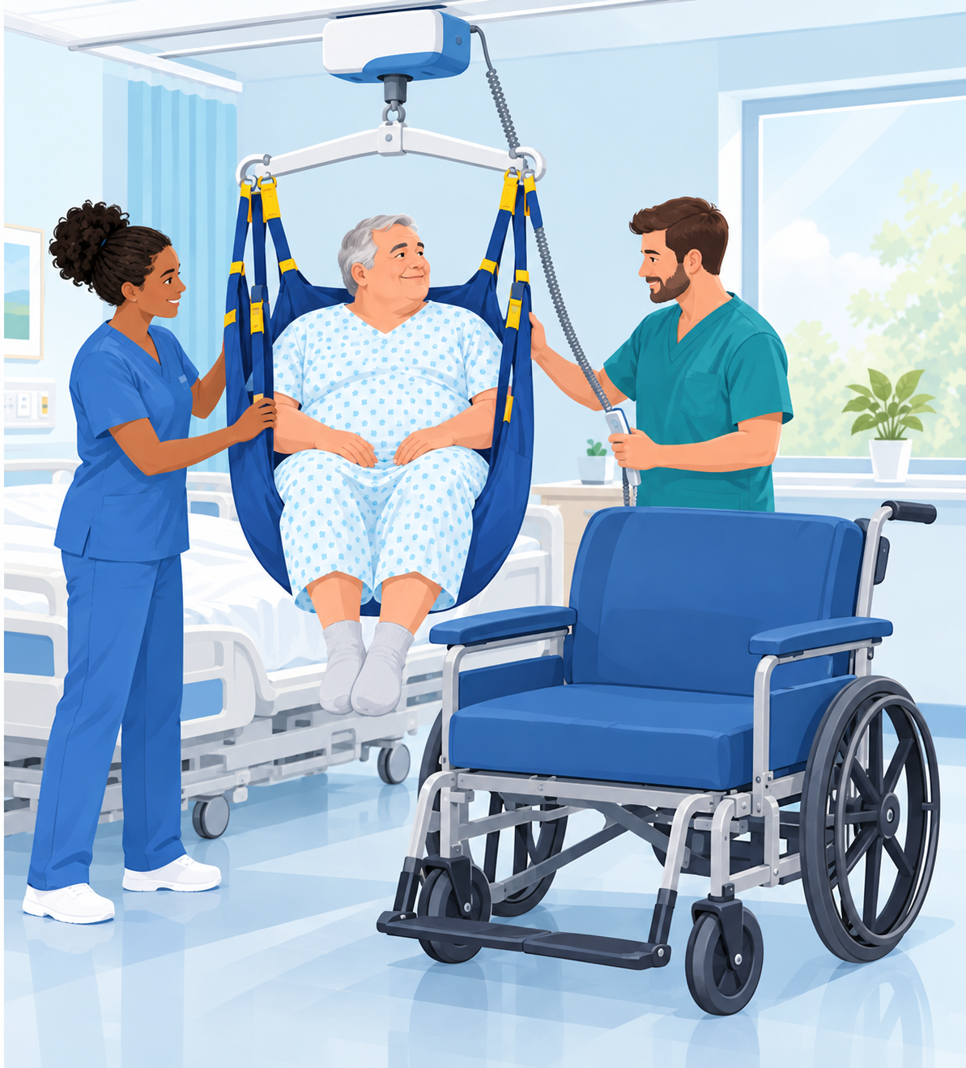
Bariatric patient handling
10%
Patients with a BMI over 35 make up only about 10% of the patient population...
...but handling them was associated with:
29.8%
of injuries
27.9%
of lost time
37.2%
of restricted time
Randall SB, Pories WJ, Pearson A, Drake DJ. Expanded OSHA 300 log as metric for bariatric patient-handling staff injuries. Surg Obes Relat Dis. 2009;5(4):463–468.
Notes:
Bariatric patients carry an outsized share of the injury risk.
Patients with a BMI over 35 make up only about 10% of the patient population. Yet handling them was associated with 29.8% of staff injuries, 27.9% of lost time and 37.2% of restricted time.
So a small group of patients accounts for roughly a third of the harm. These are exactly the moves where bariatric lifts, larger slings, air-assisted lateral transfer devices and enough staff matter most. Never attempt a manual bariatric transfer.
Source: Randall SB, Pories WJ, Pearson A, Drake DJ. Expanded occupational safety and health administration 300 log as metric for bariatric patient-handling staff injuries. Surg Obes Relat Dis. 2009;5(4):463–468.
[Illustration suggestion: two staff using a bariatric ceiling lift and large sling to transfer a larger Veteran from bed to a bariatric wheelchair.]

Slide 10
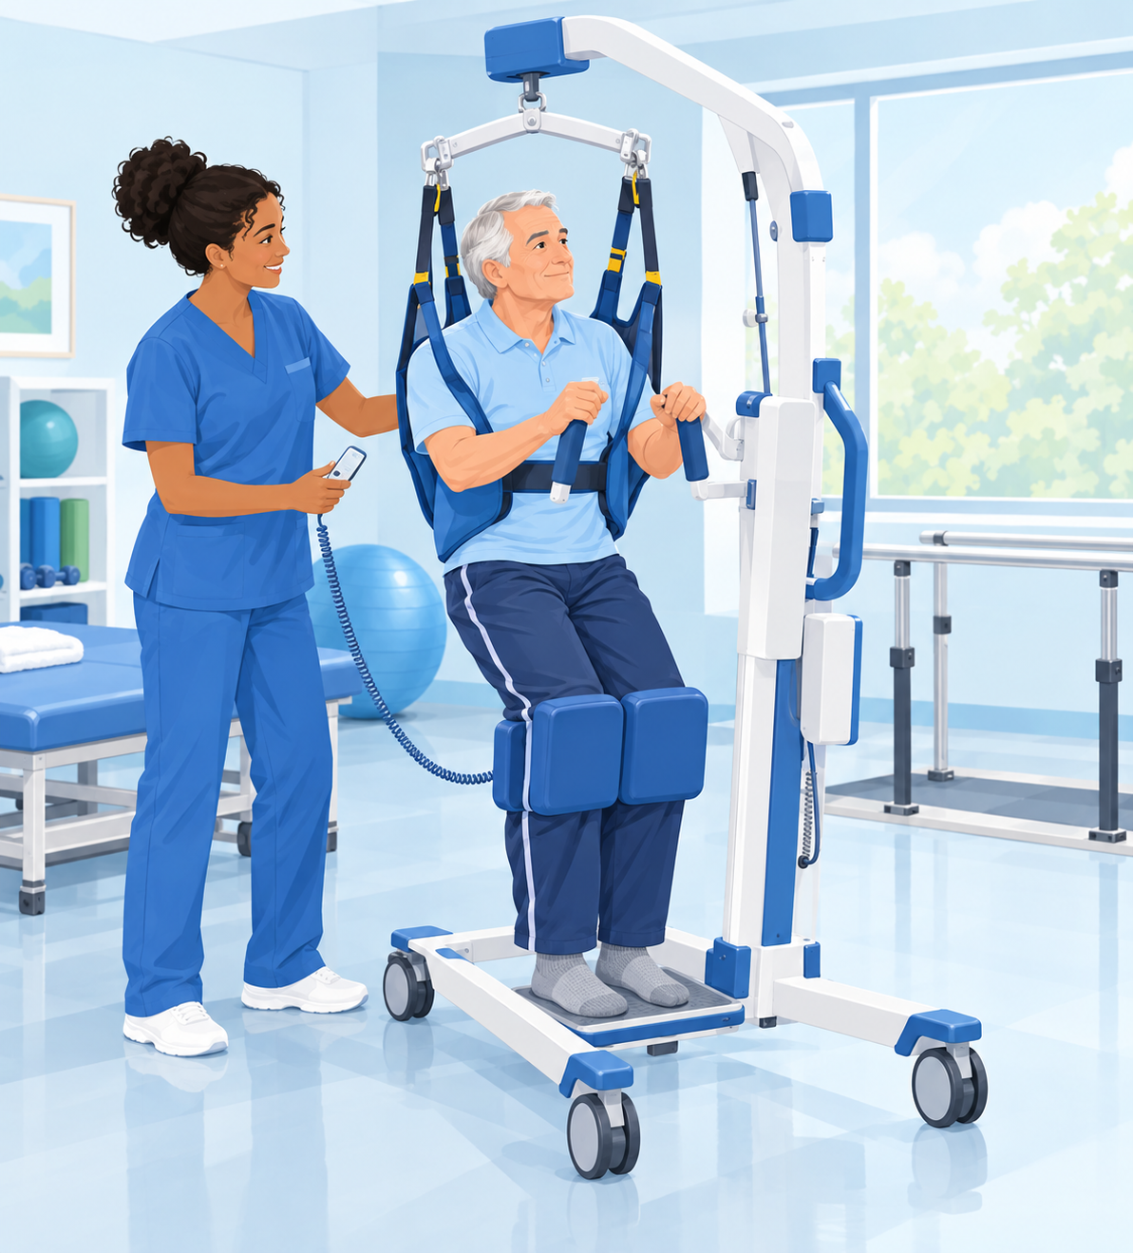
What SPHM sets out to do
1
Decrease injury risk
Reduce the risk of musculoskeletal injuries for ALL health care workers.
2
Mobilize patients
Make patient mobilization easier, along with the benefits that come with it.
3
Improve care
Improve the quality of care and the quality of life of our Veteran patients and residents.
Notes:
So what does an SPHM program set out to do? Three goals:
1. Decrease the risk of musculoskeletal injuries for ALL health care workers: nursing, therapy, radiology, transport, environmental services, anyone who moves or positions patients.
2. Make patient mobilization easier, and get the benefits that come with it: fewer complications of immobility such as pressure injuries, deconditioning and falls.
3. Improve the quality of care and the quality of life of our Veteran patients and residents.
[Illustration suggestion: a nurse helping an older Veteran stand with a powered sit-to-stand lift in a therapy room.]

Slide 11
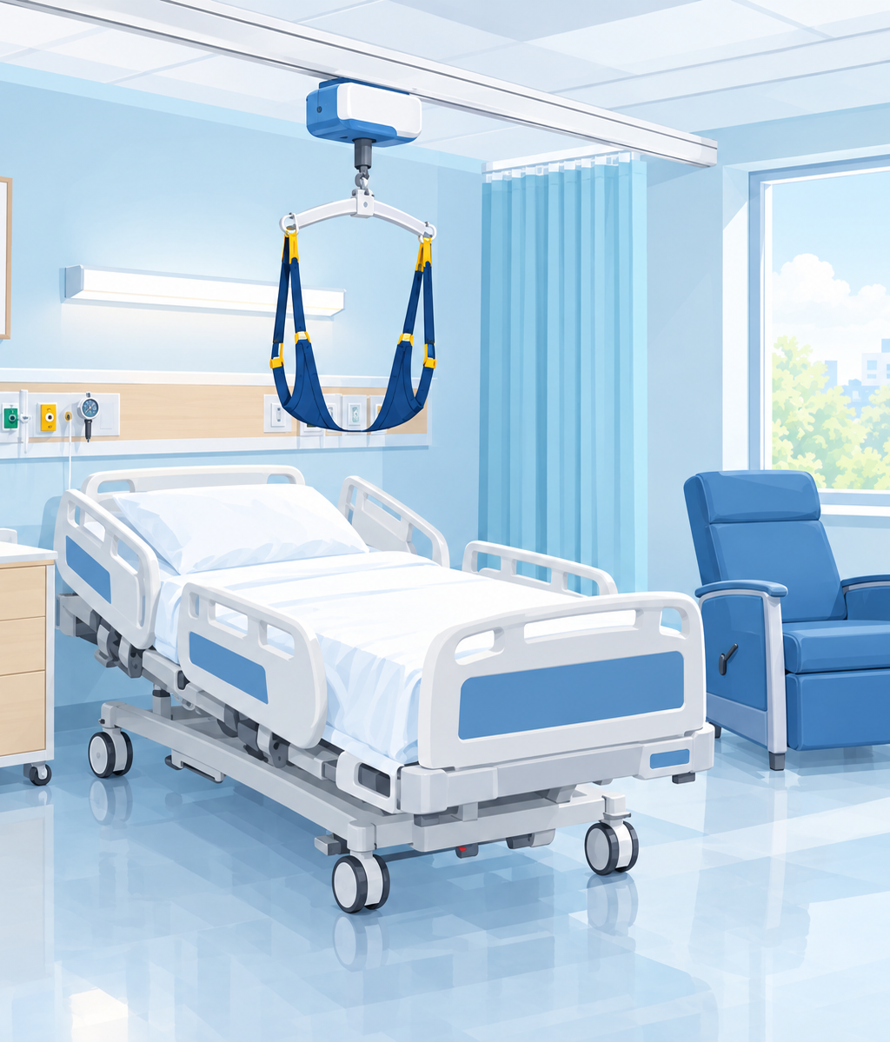
What is the VA SPHM program?
National SPHM directive
VHA Directive 1611, Safe Patient Handling and Mobility Program (replaced VHA Directive 2010-032, Safe Patient Handling Program and Facility Design)
Requires an SPHM program in every facility
✓
Every program includes the same core elements
✓
Requires planning for SPHM in design and construction
✓
Notes:
What is the VA SPHM program?
It's set by a national directive. The original was VHA Directive 2010-032, Safe Patient Handling Program and Facility Design. Today it's VHA Directive 1611, Safe Patient Handling and Mobility Program.
The directive:
- Requires an SPHM program in every VA facility
- Requires every program to include the same core elements (next slide)
- Requires planning for SPHM in design and construction, which is why newer patient rooms have ceiling-lift tracks built in
[Illustration suggestion: a modern VA patient room with a ceiling-lift track running over the bed.]

Slide 12
SPHM program elements
1
2
3
Facility policy
Local SPHM policy: MCP 118-21-013 at VACCHS.
Leadership
Program Manager (at least 1 FTE) · Unit Peer Leaders (1 per shift per clinical area) · VISN point of contact.
Training
For multiple services and levels of staff.
4
5
6
Patient assessment
A process to recommend the right equipment for each patient's individual needs.
Committee oversight
A facility committee: ARB, EOC or another.
Equipment
Overhead lift systems and other equipment as needed, based on unit ergonomic assessments.
Notes:
Every VA SPHM program has the same core elements:
1. A facility SPHM policy. Ours is Medical Center Policy 118-21-013.
2. Leadership: an SPHM Program Manager (at least one full-time position), a Unit Peer Leader program with one UPL per shift per clinical area, and a VISN point of contact.
3. Training across multiple services and levels of staff, including this orientation.
4. A patient assessment process, used to recommend equipment for each patient's individual needs.
5. Oversight from a facility committee, such as the ARB, EOC or another committee.
6. Equipment: overhead lift systems and other equipment as needed, determined by unit-based ergonomic assessments.
Your Unit Peer Leaders are your go-to people on the unit for equipment questions and hands-on help.

Slide 13
Use the right tools
Using SPHM equipment protects both staff and Veterans.
Use the right SPHM equipment for patient handling and mobility tasks.
Equipment works best when it's available, in working order, and staff are trained to use it.
If equipment can't be used, communicate the barrier and get help before proceeding whenever possible.
After an injury or near miss, report it promptly so the team can review it and improve safety.
Plan the move. Use the equipment. Ask for help.
Notes:
Safe patient handling means using the right tools.
- Using SPHM equipment helps protect both staff and Veterans.
- Use the appropriate SPHM equipment for patient handling and mobility tasks.
- Equipment works best when it's readily available, in working order, and staff are trained to use it.
- If equipment can't be used, communicate the barrier and seek help before proceeding whenever possible.
- After an injury or near miss, report it promptly so the team can review what happened and improve safety.
Key message: safe patient handling is a shared responsibility. Plan the move, use the equipment, and ask for help.
SPHM is about preventing injuries through planning, teamwork and the consistent use of available equipment. Reporting barriers and near misses helps us improve the system. It's not about placing blame.

Slide 14
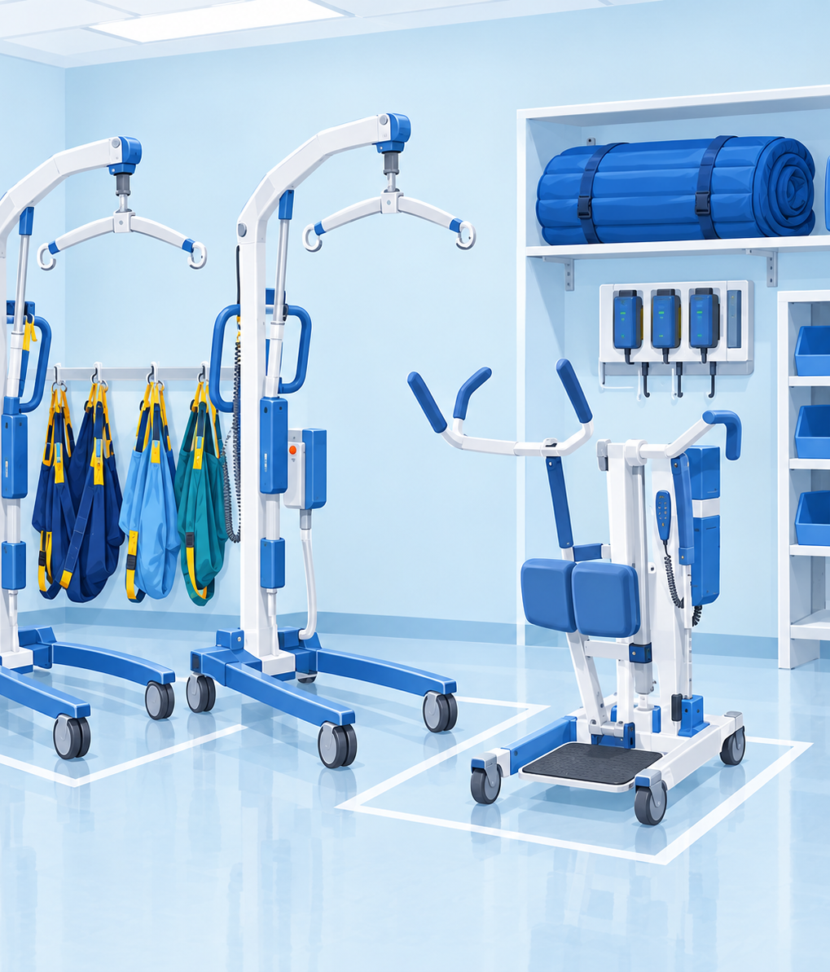
Patient handling equipment & aids
Lifts, slings, transfer devices and mobility aids you'll see on your unit.
Notes:
Let's look at the equipment and aids you'll see on your unit. You don't need to memorize them today. Your Unit Peer Leaders and unit-based training will show you how to use what's on your unit.
[Illustration suggestion: a tidy SPHM equipment room with floor lifts, a sit-to-stand lift, slings on hooks and an air-assisted transfer mattress.]

Slide 15
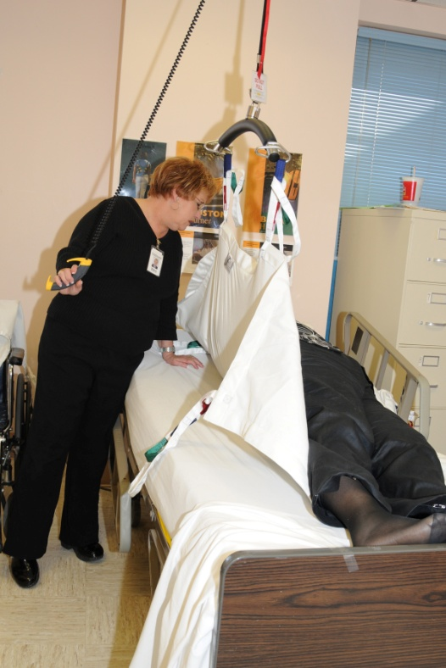
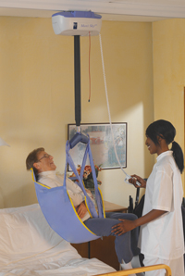
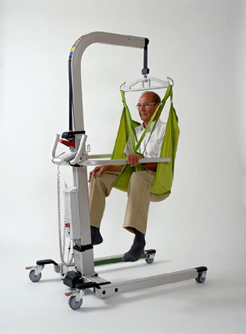
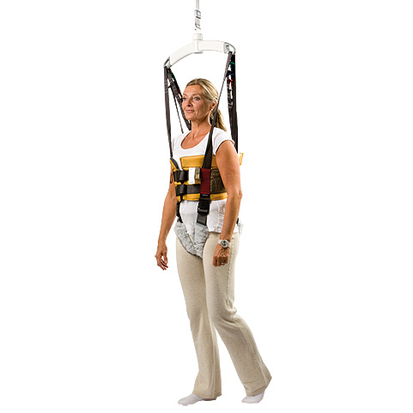
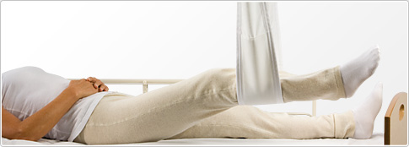
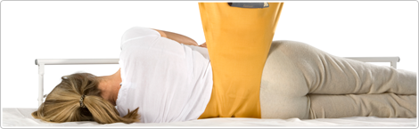
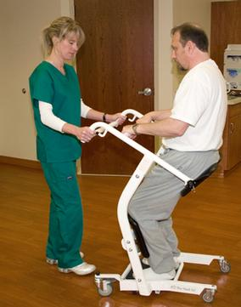
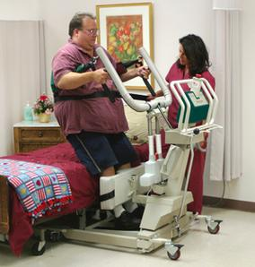
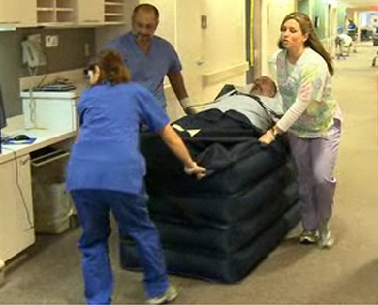
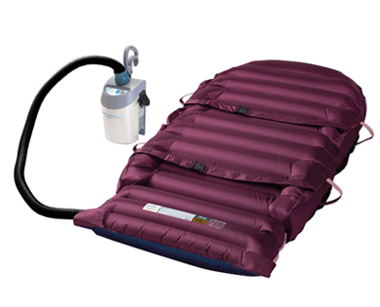
Notes:
Patient handling equipment, part 1 (clockwise from upper left):
1. Ceiling lift with repositioning sling
2. Ceiling lift with seated sling
3. Floor lift with seated sling
4. Walking (ambulation) sling
5. Turning sling
6. Evacuation HoverJack
7. HoverMatt (air-assisted lateral transfer)
8. Bariatric-capacity sit-to-stand lift
9. Non-powered stand aid
10. Limb lifter
Point out which of these are on the units your new staff will be working on.

Slide 16
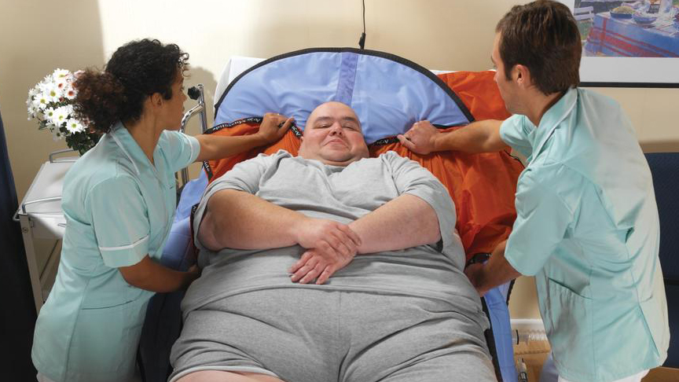
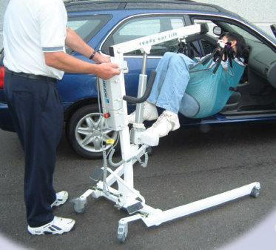
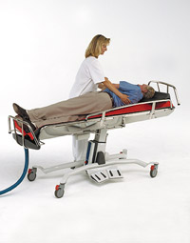
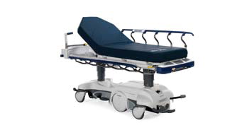
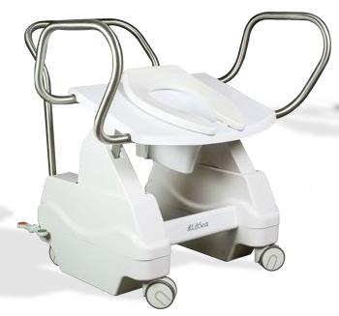
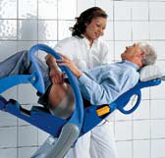
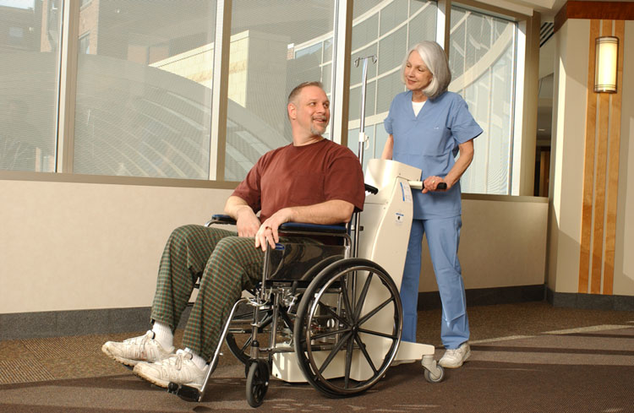
Notes:
Patient handling equipment, part 2 (clockwise from upper left):
1. Slide sheet, used to install a sling
2. Car lift
3. Turning shower trolley
4. Ergonomic, hip-elevating hygiene chair
5. Powered, elevating toilet seat
6. Motorized wheelchair mover
7. Motorized stretcher
SPHM isn't just lifts. It covers bathing, toileting, transport and vehicles too.

Slide 17
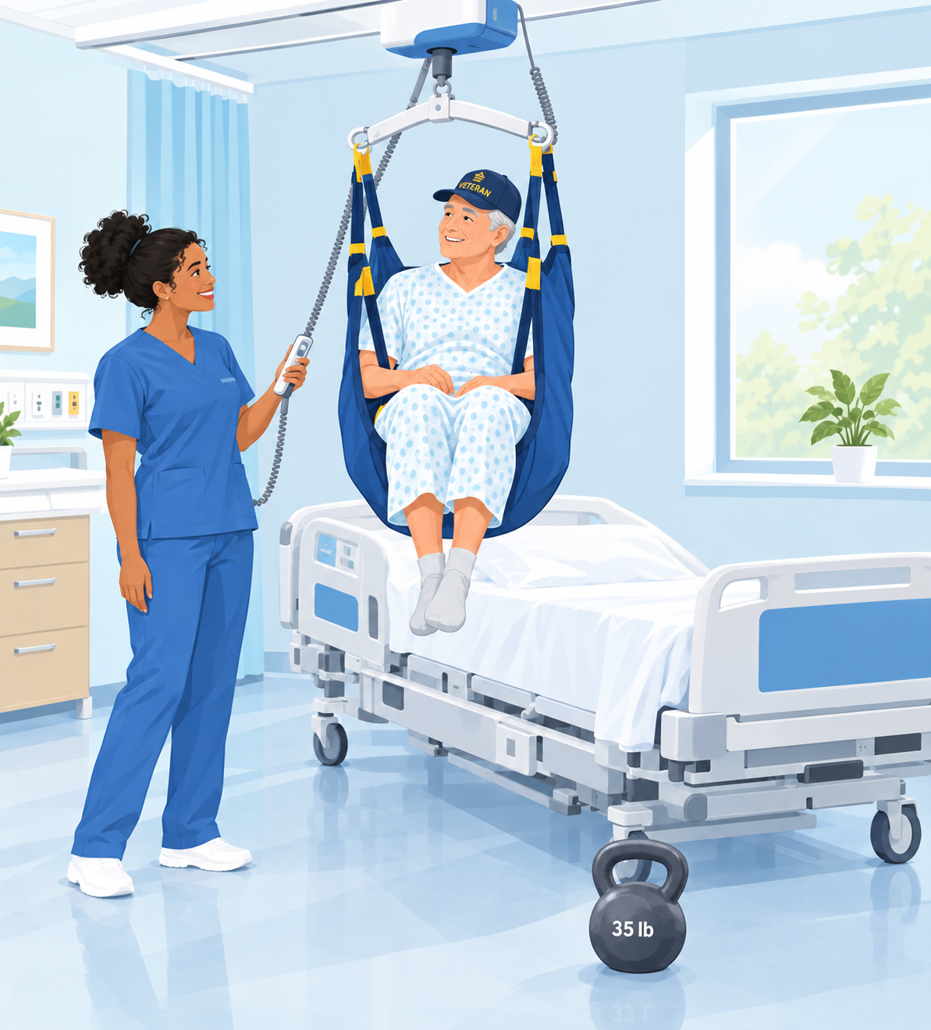
100 pounds is not “light”
Health care workers are the ONLY occupation that believes 100 pounds is light!
100 lb
what we often try to lift manually
35 lb
the safe limit for lifting patient weight
Anything over 35 lb, or any move that needs excessive force: use the equipment.
Notes:
Here's a reality check: health care workers are the only occupation that believes 100 pounds is light!
In almost any other job, lifting 100 lb would mean a mechanical lift or a team. In health care we often try to "just do it" ourselves, especially when we're busy or the patient is small or cooperative.
The recommended limit for lifting patient weight is 35 lb, under ideal conditions. Anything over that, or any move that needs excessive force, means using the equipment.
[Illustration suggestion: a cheerful nurse standing back while a ceiling lift does the lifting of a Veteran, with a "35 lb" kettlebell on the floor nearby.]

Slide 18
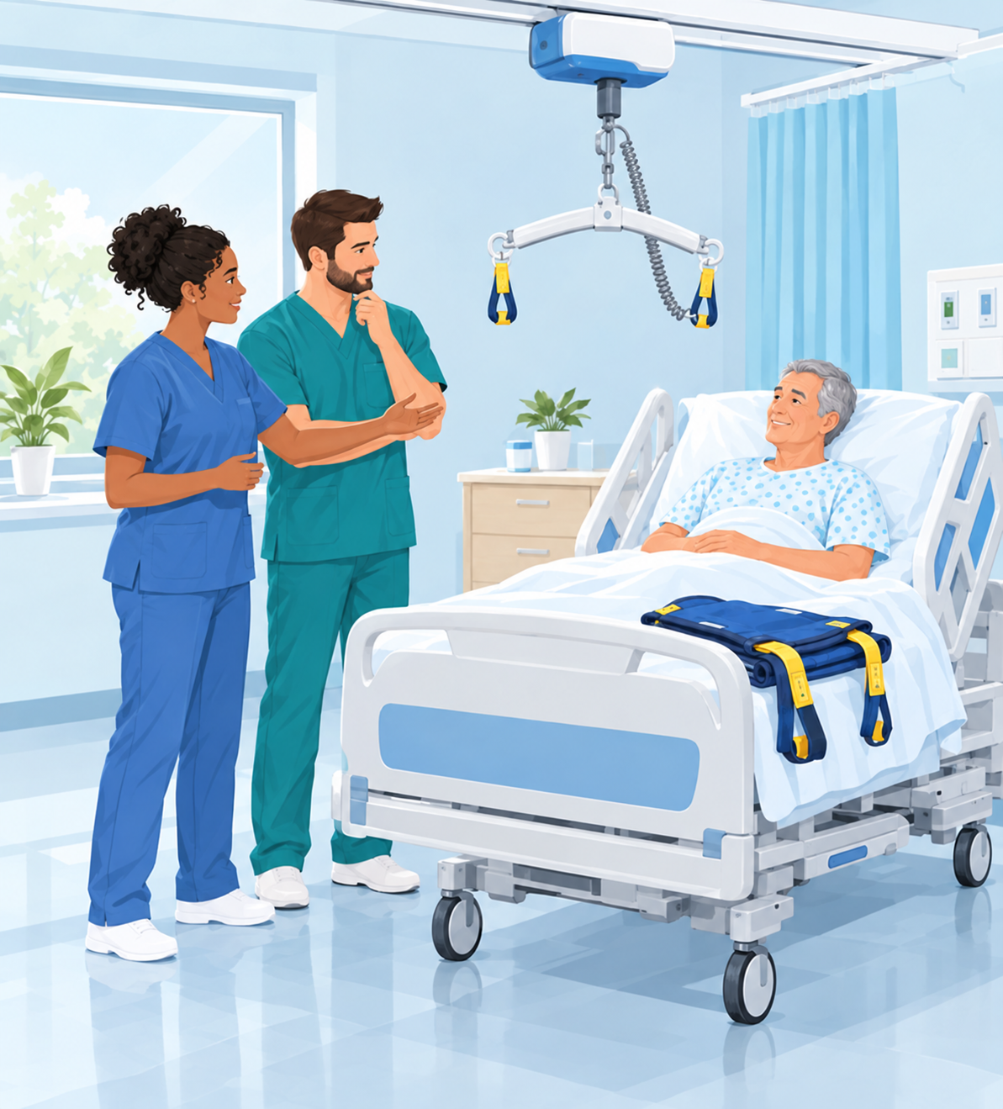
Take the time
Use the Safe Patient Handling equipment to SAVE YOUR SPINE.
1
Plan the move
Assess the patient and the task before you start.
2
Use the equipment
Lifts, slings and transfer aids, every time.
3
Ask for help
Get the right number of people and your Unit Peer Leader.
REMEMBER: Do not lift more than 35 lb of patient weight!
Notes:
Take the TIME. It only takes a minute or two to get the lift, and it can save your career.
Use the Safe Patient Handling equipment to save your spine:
- Plan the move: assess the patient and the task.
- Use the equipment: lifts, slings and transfer aids, every time.
- Ask for help: get enough people, and lean on your Unit Peer Leader.
REMEMBER: do not lift more than 35 lb of patient weight.
[Illustration suggestion: two nurses pausing at the bedside to plan a transfer together, with a ceiling lift and sling ready.]

Slide 19
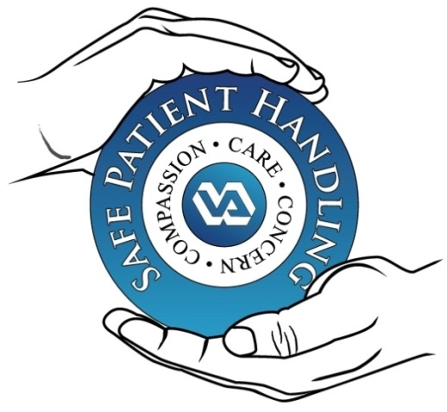
Thank you
Questions?
Daniel Agbogidi, BSN, RN
SPHM Program Manager
VA Central California Health Care System
Compassion · Care · Concern
Notes:
Thank you. Remember the key messages:
- SPHM is required, nationally and at VACCHS.
- Don't manually lift more than 35 lb of patient weight, or use excessive force. Use the equipment.
- Plan the move, use the equipment, and ask for help.
- Report injuries, near misses and equipment barriers promptly.
Questions? Contact me, your SPHM Program Manager, or your unit's Unit Peer Leaders.

